Slide 1

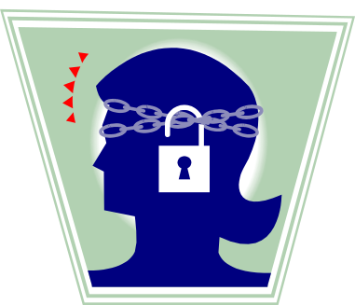
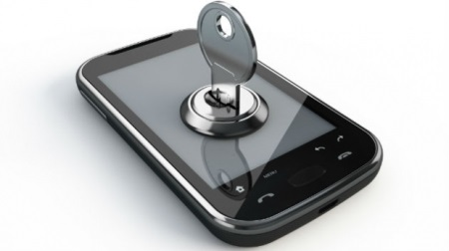
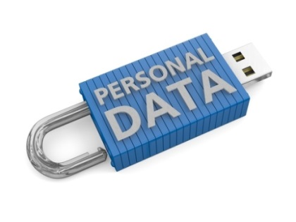
GOVERNING & PROTECTING
Personal Data
OCTOBER 20, 2015

Slide 2
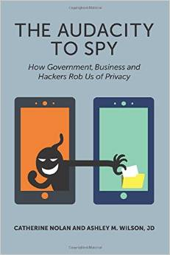
Cathy Nolan, Data Analyst
cnolan@allstate.com
Ashley Wilson, Attorney
wilsonsport17@gmail.com

Slide 3

Corporate Obligations
Corporate responsibilities for Personal Data
  Use secure handling and storage
  Tell users how data is being used
  No misrepresentation of uses of data
  Don’t use if adverse to user’s interests without explicit consent.
  Honor commitments made
  regarding handling of data

Slide 4

HP Survey on Security Risks
Need to design Security from start of projects
  Less resource investment early in life-cycle
Goals not the same for everyone
Gaps between Builders and Defenders
  Put PII* security on “someone else”
    Force Security through Compliance Reviews
*Personally Identifiable Information

Slide 5

Builders vs Defenders
Builder
  Focus on delivering features
    Speed to market
    Security not a priority
    Java and .net have most (perceived) security risks
Defender
  Identify applications with PII information
  Fear of modifying production code
  Most concerned with public-facing aps
  Organizational silos between security and application development
*Source HP

Slide 6

Who will Bridge Silos?
Data Governance & Data Modelers uniquely positioned to identify & safeguard PII data
  Work with Business & IT
  Have broad knowledge of company’s data
  Research & write the data definitions
Need Buy-in of all stakeholders
  Continuing support
  Solicit feedback
PII is a legal concept – not a technical concept
  Developers not equipped to classify PII data

Slide 7

Governing & Protecting Personal Data
It is the responsibility of every employee to properly protect the personal data entrusted to their organization.
Organizations need to have rules and processes to decide how personal information is used inside and outside the business.

Slide 8
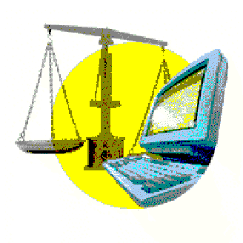
What is Sensitive Data?
Sensitive data encompasses a wide range of information and can include: your ethnic or racial origin; political opinion; religious or other similar beliefs; memberships; physical or mental health details; personal life; or criminal or civil offences. These examples of information are protected by your civil rights.

Slide 9
4 Components To Consider
Governance
Compliance
Risk
Identify PII data pre-database implementation
Manage and Control
Organization’s Data
Modeling
Identify, Monitor
& Mitigate Risks
Ensure Compliance
With Laws &
Regulations

Slide 10
Data Modelers
Data Profiling
  Uncover sensitive data
  Determine where sensitive data is located
Be Pro-active
  Look at older models
  Look for potential legal issues with data
Help Define Data Masking Formats
  For testing, replace sensitive information with realistic data based on masking rules.

Slide 11

Data Modeling
Data Modelers should be aware
of laws concerning PII data
Work with Data Governance to identify where PII data is stored
Help Determine how long to keep data
  Business wants to keep data forever
  Risk the use in litigation
  Risk of old “sensitive” data in databases

Slide 12
Data Modeling & Data Governance
Organizations that do not model their data ….(have) data riddled with inconsistency and misunderstanding. Ask any organization that does not model their data if their data is being governed. The sure answer will be “no”.
Robert Seiner
TDAN

Slide 13

Governance Council
Recommend standards and procedures for safeguarding personal data
Partner with legal and IT to restrict confidential and/or personal data
Monitor compliance regulations and identify exceptions
Reconcile privacy and security issues
Identify who has authority to make decisions
Coach developers on privacy & security

Slide 14

Governance Council
Data Profiling
  Uncovers sensitive data
  Determines where sensitive data is located
Audit
  How many people have access to sensitive (internal) data
  For what purpose?
  Who gives them access authority?
  Does the data leave the building?

Slide 15

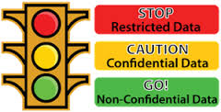
Classifications of Data
PUBLIC
Will not harm organization if data is available internally or to the public
CONFIDENTIAL
Data available only to authorized users
RESTRICTED
Could cause financial, legal, regulatory or reputational damage if disclosed or compromised

Slide 16
Data Classification Chart
TYPE OF DATA | INFORMATION CATEGORY | CLASSIFICATION
Age | Personal Demographic | Confidential
Customer Income | Financial | Confidential
Education | Demographic | Confidential
Weight | Demographic | Confidential
Truncated SSN | Personal Identification | Confidential
Telephone Number | Contact (Personal) | Confidential
Medical Test Results | Medical | Restricted
Date of Birth | Personal | Restricted
Driver's License | Government Issued ID | Restricted
Salary | Financial | Restricted
Passport Number | Government Issued ID | Restricted
License Plate Number | Government Issued | Restricted
Tribal ID | Government Issued ID | Restricted
Social Security Number | Government Issued ID | Restricted
Bank Account Number | Financial | Restricted

Slide 17
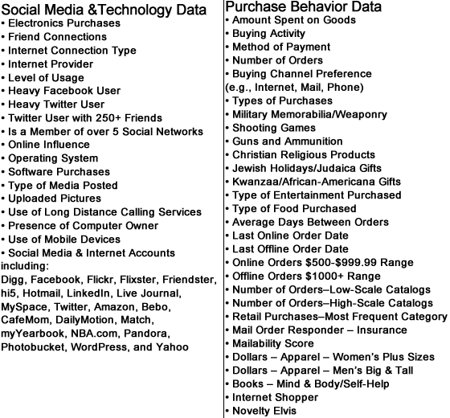

Slide 18
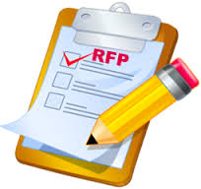
PII Vendor Data
Data Governance needs to be involved in RFP
  Does vendor’s data follow your organization’s standards?
    Do they have data management & data governance?
    Will vendor share this information?
  Assess vendor’s security procedures
    Do they have a data security team?
    Do they have the technology to handle threats?

Slide 19
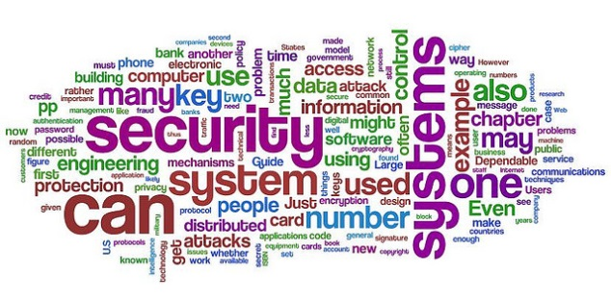
70% Organizations Use Open-Source or Vendor Data
Majority of Fortune 500 companies have downloaded apps with known security vulnerabilities
  Heartbleed, ShellShock, POODLE and FREAK
  National Vulnerability Database - SANS
DG analysts don’t necessarily have to understand the all the technical aspects but need to know what to look out for when reviewing code
Builders responsible for adding security into the development life cycle

Slide 20
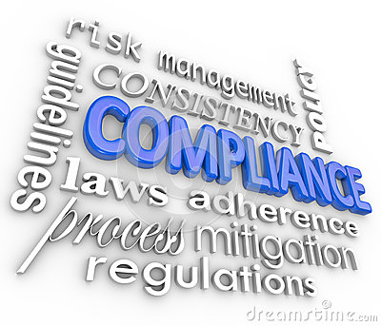
Compliance
In the US, there is no single, comprehensive federal law regulating the collection & use of personal data. The US has a patchwork of federal & state laws, & regulations.
Organizations often must decide between conflicting compliance regulations
  Residence of Individual where PII was obtained
  Type of data collected
  How will data be used
    Written consent?

Slide 21


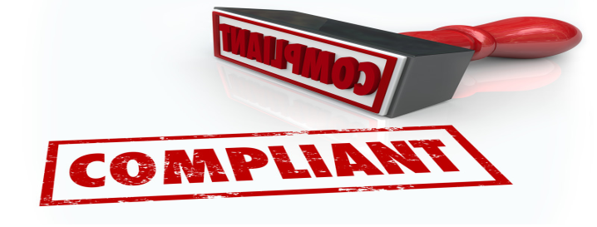
Compliance
FCRA - The Fair Credit Reporting Act
  Applies to consumer's creditworthiness, credit history, credit capacity, character, and general reputation that is used to evaluate a consumer's eligibility for credit or insurance.
HIPAA – Health Insurance Portability & Accountability Act
  Security Breach Notification Rule which requires covered entities to provide notice of a breach of protected health information.
  1.5 million fine by a health insurance company for alleged violations of HIPAA privacy and security rules

Slide 22
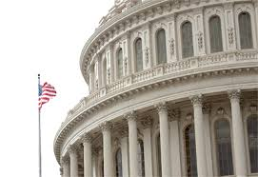
Federal Legislation
The House passed two information sharing bills that would encourage voluntary sharing of cyber threat information between companies and the government, while providing necessary privacy protections for consumers and liability protection for companies during the sharing process

Slide 23
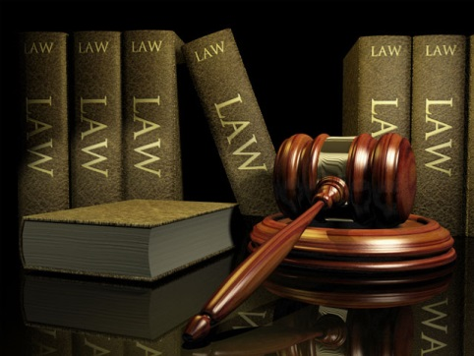
New Legislation
Personal Data Protection and Breach Accountability Act of 2014 would require business entities to do the following:
  Implement a comprehensive program that ensures the privacy, security, & confidentiality of sensitive PII
  Establish a federal security breach notification procedure

Slide 24
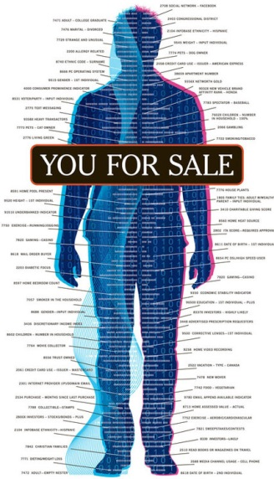
New Legislation
Data Broker Accountability & Transparency Act
  Require data brokers to establish reasonable procedures to ensure the accuracy of the personal information it collects or maintains
  Provide consumers with the right to review data collected by data brokers
  Require data brokers to offer consumers a
  way to opt-out of having their personal
  information shared for marketing purposes

Slide 25

California State Laws
Data Security Law requires businesses to implement and maintain reasonable security procedures to protect personal information from unauthorized access, destruction, use, modification, or disclosure.
Shine the Light law requires companies to disclose details of the third parties with whom they have shared their personal information

Slide 26

Risk Management
Assess risks of future (data) security breaches
Help design a data privacy and security program to control such risks
Decide how long to keep data
  Risk the use in litigation
  Risk of old “sensitive” data in databases

Slide 27
Data Breach?
Form a Task Force
  Speak with one voice
  Responsible for communication about Breach
    Internal – Data Governance, Security
    External –CIO, Legal, Public Relations
Report Breach
  Customers
  Federal and/or State Agencies

Slide 28
Data Breach?
Look for other Potential Flaws
  Legacy data not updated?
  Sensitive data not encrypted?
  Data not secure on laptops taken out of building?
  Data not disposed of properly – shredded?
Do an Honest Assessment of Breach
  What happened to cause the incident
    Incomplete developer training?
    Vendor Data introduced spyware?
    Theft of company data by insiders?

Slide 29

Conclusion
Data Governance is key to Personal Data Privacy and Security
When dealing with PII:
  Proactively protect customer & employee data
  Preserve and enforce customer’s instructions
  Evaluate security and privacy risks
  Adopt rules for confidential & restricted data
  Assist risk management & compliance teams

Slide 30
Conclusion
DG should insist on oversight of all development phases
Work with Risk Mgmt. to estimate economic impact of breaches
Coach developers on security
Be Pro-active, don’t wait to be forced to act

Slide 31

Questions? Comments?

